Slide 1

v9 New Feature Overview Part 2
DYNAMICS 365

Slide 2

Mitch Milam
mitch@xrmcoaches.com
@mitchmilam
linkedin.com/in/mitchmilam
youtube.com/xRMCoaches

Slide 3
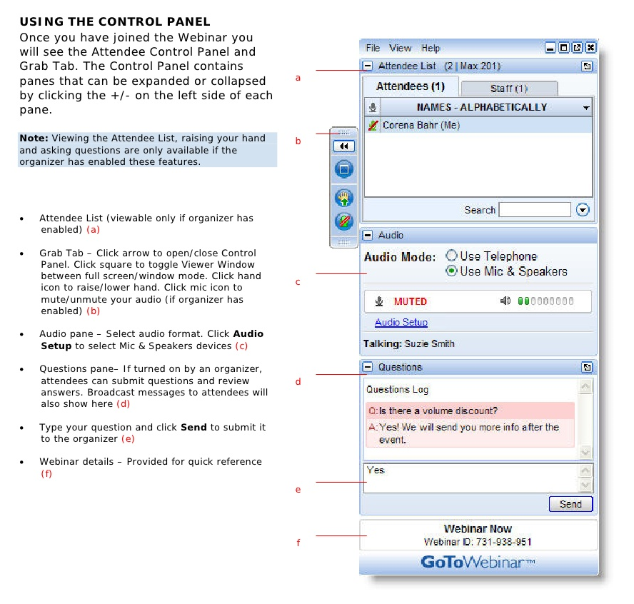
Webinar Housekeeping

Slide 4
Agenda
When
Where
Why
Technology
Tools

Slide 5
Overview
General Availability
1st week of October

Slide 6
New Feature Overview

Slide 7
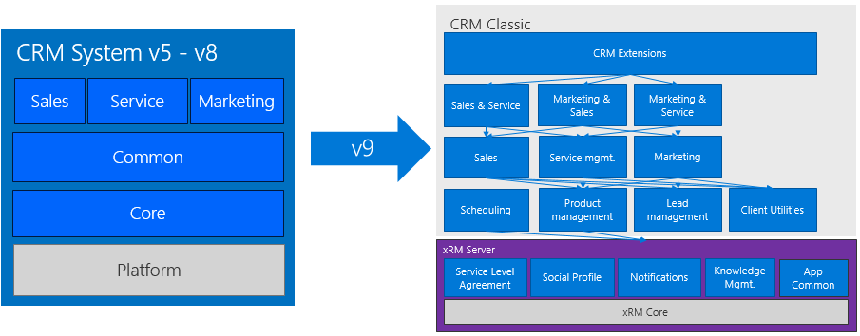
Platform Separation

Slide 8
Apps
Let’s talk about apps

Slide 9
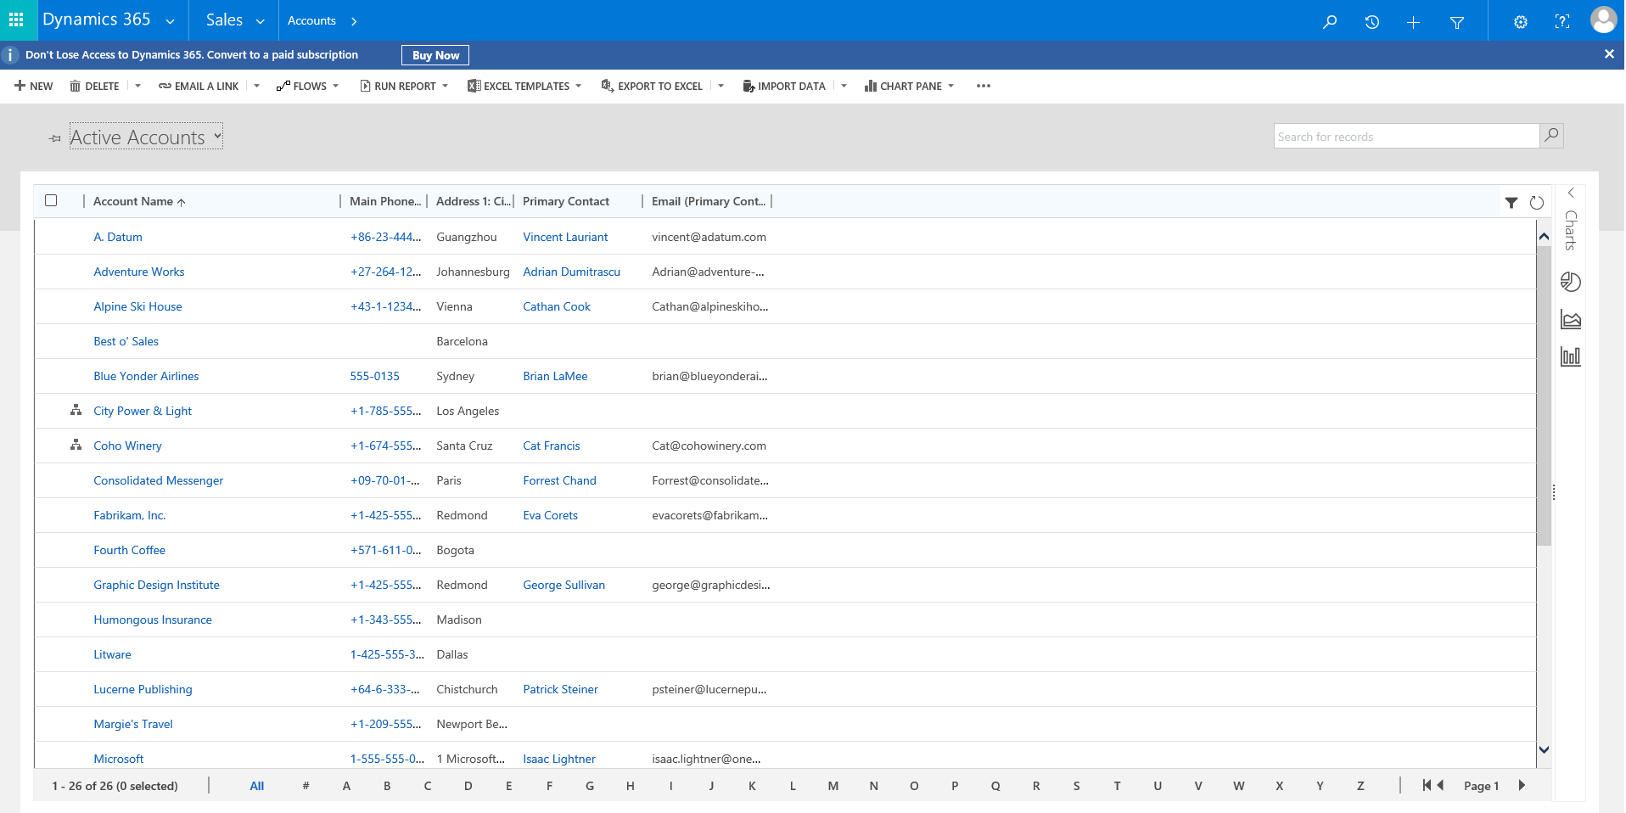
Web UI Refresh

Slide 10
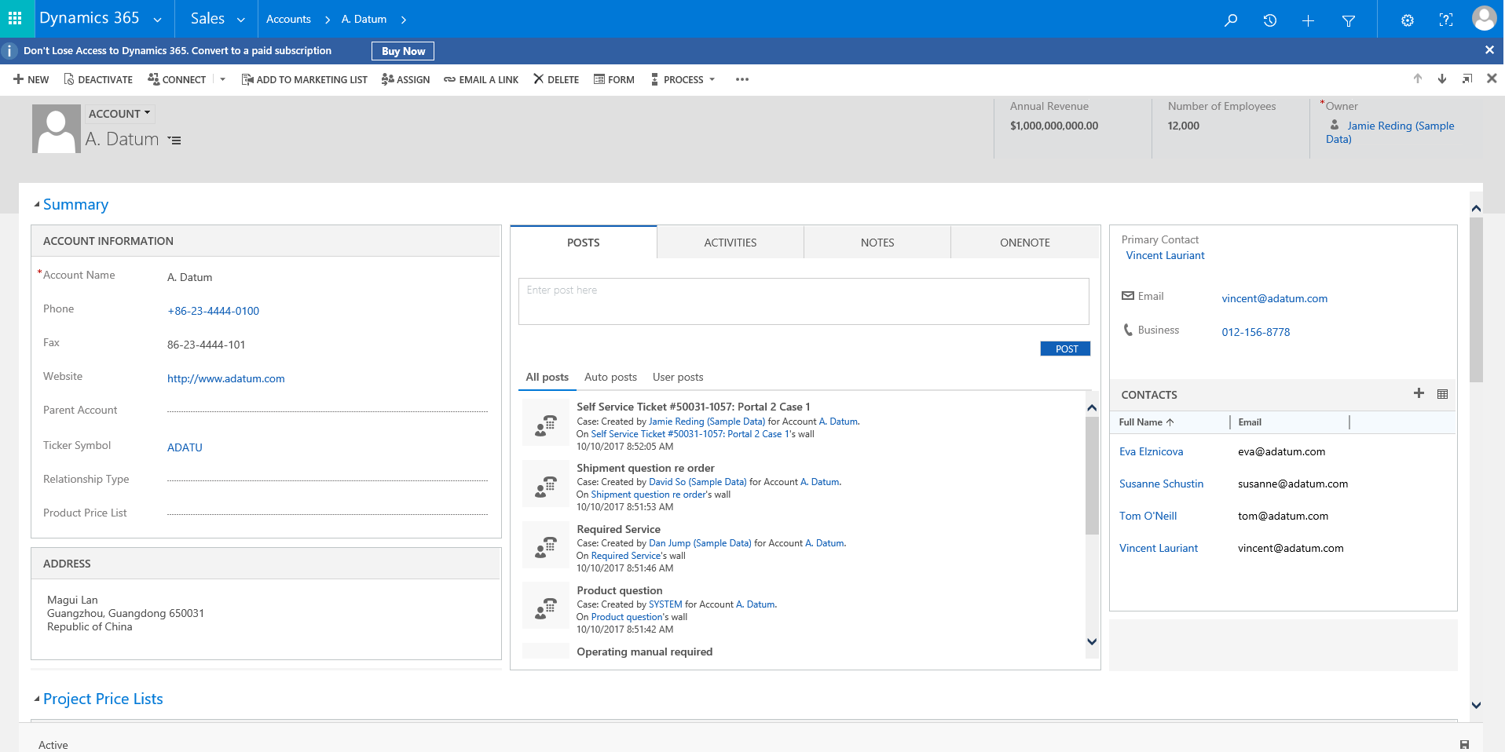
Web UI Refresh

Slide 11
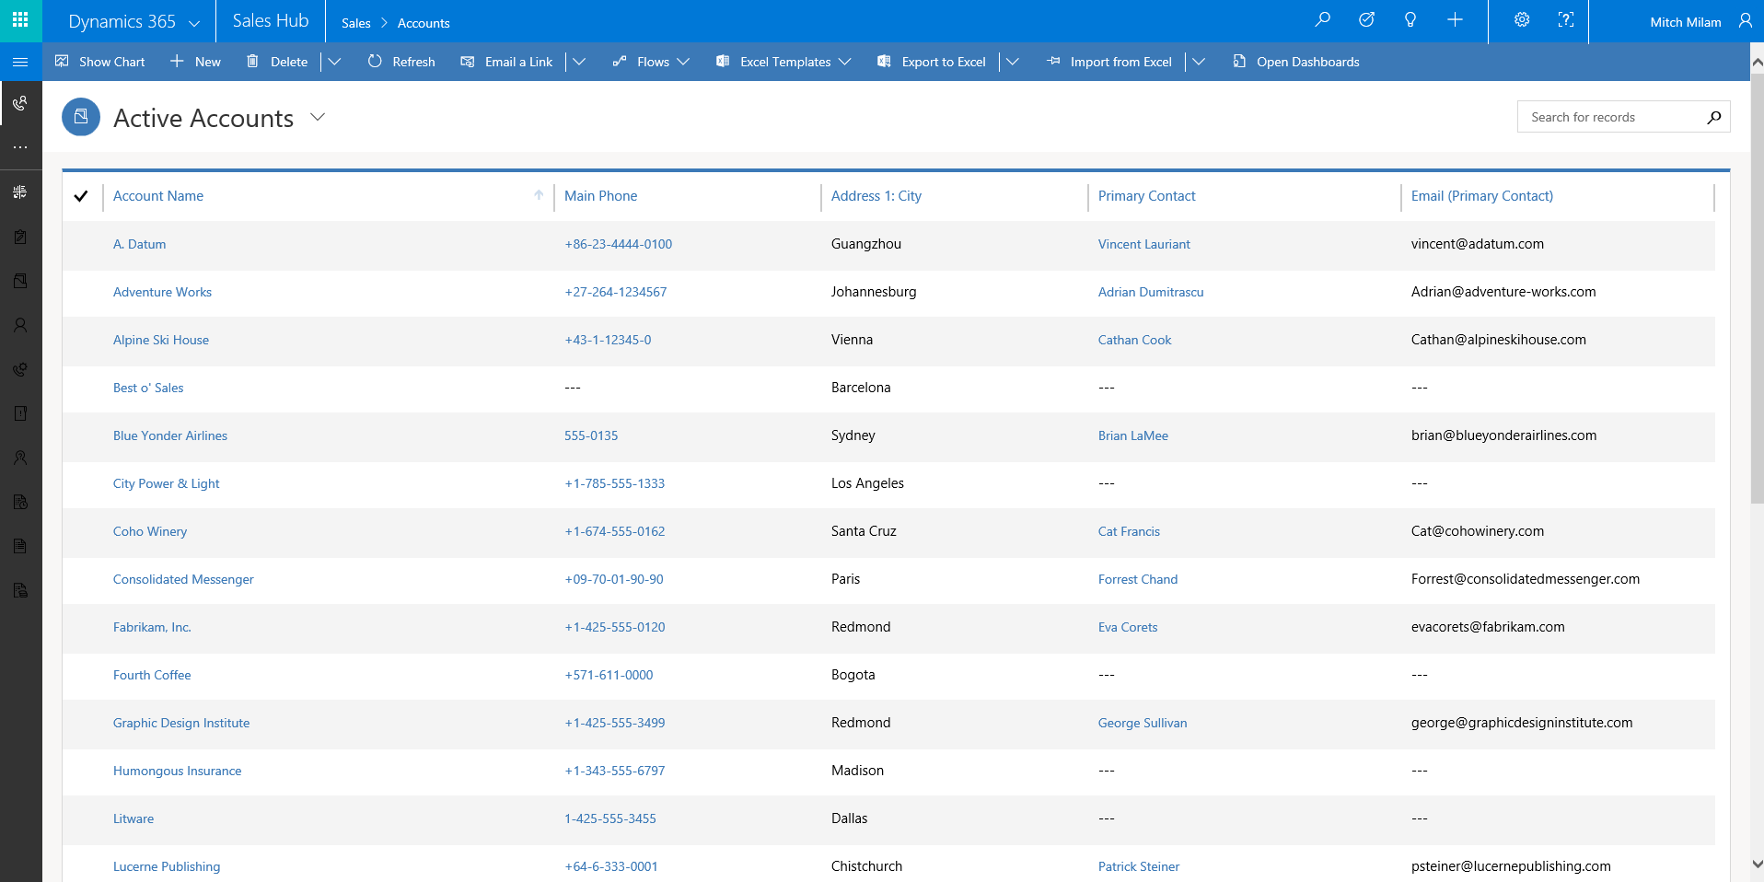
Unified User Interface

Slide 12
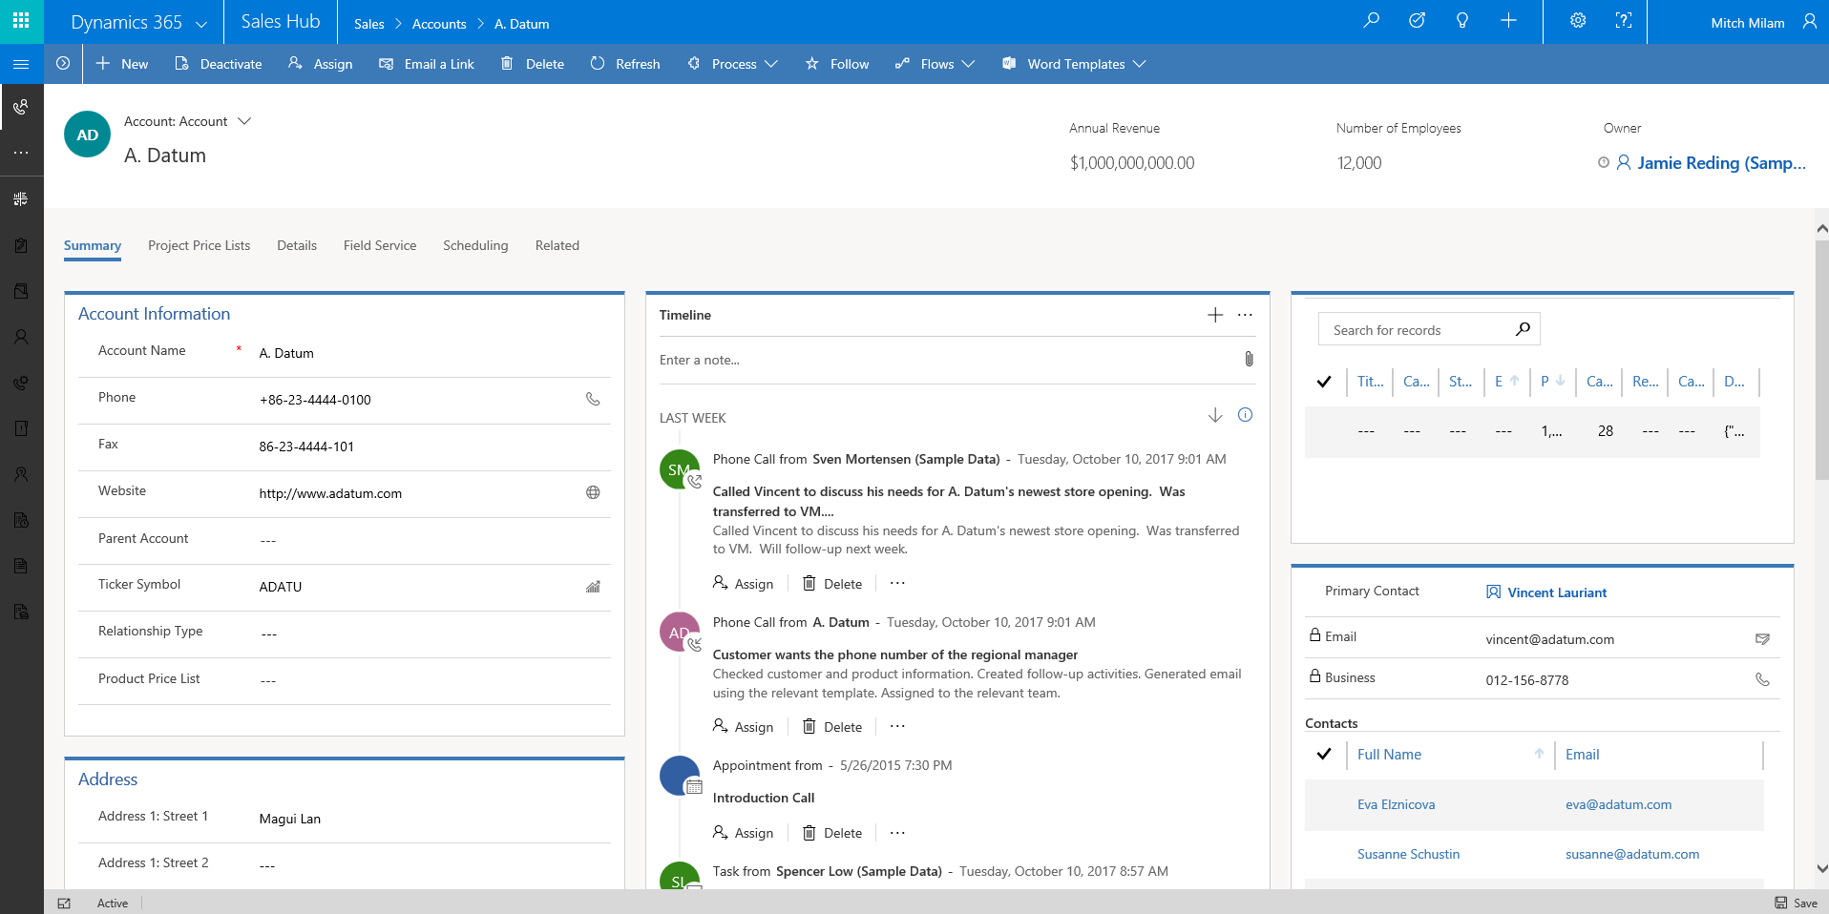
Unified User Interface

Slide 13
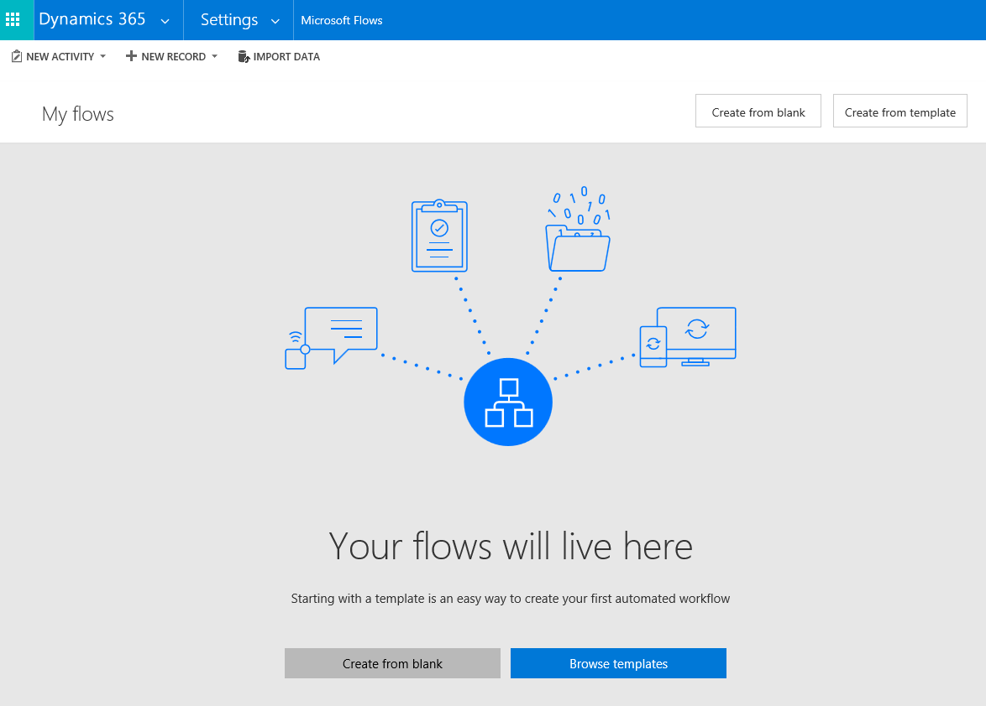
Microsoft Flow

Slide 14
Other Features
Updates to:
App Designer
Site Map Designer
Business Process Flow Designer
New Themes
NOT IN query in Advanced Find

Slide 15
Other Features
New LinkedIn Connector
Addition of “Hubs”
Sales Hub
Customer Service Hub

Slide 16
Coming Soon
Outlook App update

Slide 17
Deprecated Features
Outlook Client - replaced by the Dynamics 365 App for Outlook
Service scheduling in Dynamics 365 for Customer Service - now included with Dynamics 365 Field Service that works with Customer Service
Dialogs - replaced by business process flows and mobile task flows
Parature knowledge base as the Dynamics 365 knowledge solution - replaced by Knowledge Management features in Dynamics 365
Contracts, Contract Line Items, and Contract Templates - replaced by Entitlements in Dynamics 365 for Customer Service.
Standard SLA Type - Standard SLA's are replaced by Enhanced SLA's
Relationship Roles - replaced by Connection Roles
Mail Merge - replaced by server-side document generation using Word and Excel templates

Slide 18
For Developers
Virtual Entities
Web API improvements
Client API enhancements
Create and manage role-based, purpose-built business apps
Create and manage role-based, purpose-built business apps

Slide 19
For Developers
Vector Image web resources
Support for localizable solutions
JavaScript Web Resource dependencies
Override the default open behavior of data rows in an entity-bound grid
Business process flow enhancements
WebHooks integration

Slide 20
Deprecated Development Features
Xrm.Page model is changing

Slide 21
Demo

Slide 22
Questions?

Slide 23
Thank You

